Slide 1

Introduction to Server Hardware
A Comprehensive Guide to Architecture, Components, and Infrastructure

Slide 2

Server Deployment Models
→
On-Premises: Servers are installed and maintained physically within an organization's facility. Full control, high capital expense.
→
Cloud: Computing resources are provided and managed through external cloud platforms (AWS, Azure). High scalability, operational expense.
→
Hybrid: Combines on-premises infrastructure with cloud resources, offering flexibility and security balancing.
→
Colocation: Organization-owned servers are hosted in a third-party data center that provides power, cooling, and physical security.

Slide 3
Enterprise Server Concepts
What is a Server? A computer designed to provide services and resources to other computers continuously.
Enterprise Servers Support business-critical applications and essential network services.
High Processing Capacity Built to handle massive workloads efficiently.
Large Memory Capacity Equipped with extensive RAM for multitasking and large databases.
Redundant Components & High Availability Features like dual power supplies prevent downtime.
Remote Management Allows administrators to control the hardware over the network.

Slide 4






Server Form Factors
Tower
Rack
Blade
Standalone servers built in an upright cabinet. Function similarly to traditional desktop PCs but with server-grade components.
Flat, standardized enclosures designed to be bolted into a specialized framework (server rack) to save space.
Ultra-thin, modular servers stripped down to save space and energy, housed in a chassis that provides shared power and cooling.

Slide 5
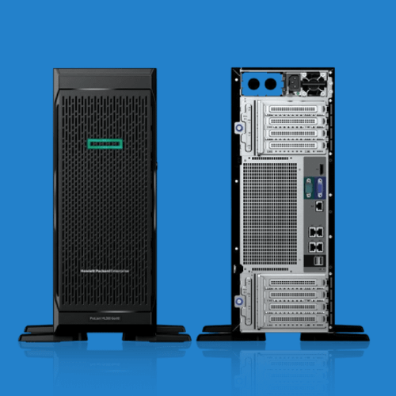
Tower Servers
Design: Standalone server with a cabinet-like physical design.
Use Case: Highly suitable for small businesses and remote offices with limited IT infrastructure.
Infrastructure: Does not require a specialized server rack or dedicated cooling room.
Maintenance: Generally easy to install, open, and physically access for upgrades.

Slide 6
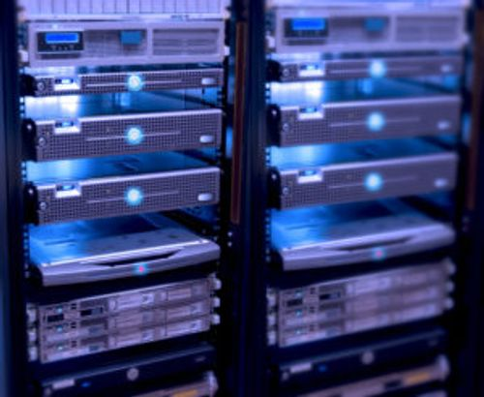
Rack-Mount Servers
→
Design: Purpose-built to fit inside standard 19-inch server racks.
→
Sizing (Units/U): Standardized sizes including 1U, 2U, and 4U (where 1U = 1.75 inches in height).
→
Environment: The standard format commonly used in large enterprise data centers.
→
Advantage: Supports highly organized, high-density deployments maximizing floor space.

Slide 7
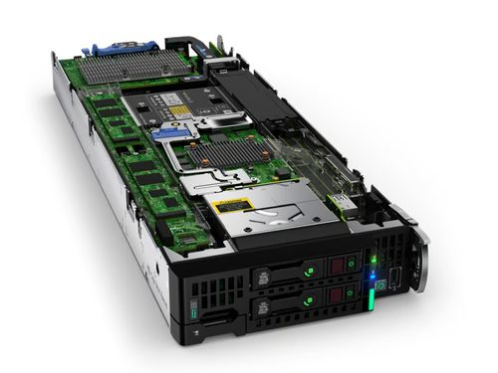
Blade Servers
Design: Thin, stripped-down server modules installed vertically inside a shared, massive chassis.
Shared Resources: The chassis itself provides centralized power, cooling, networking, and management for all blades.
Density: Provides the absolute highest server density per square foot in a data center.
Efficiency: Reduces cable clutter significantly as networking and power are handled by the backplane.

Slide 8
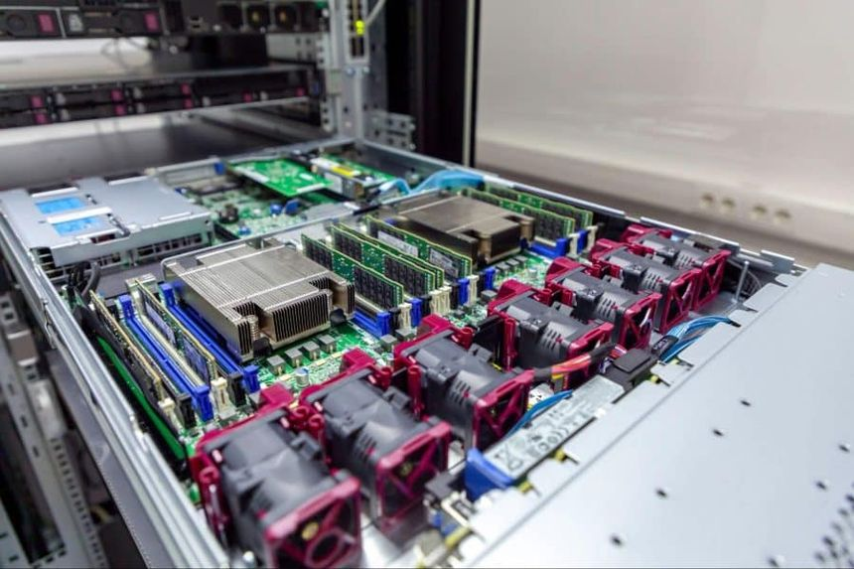
Server Architecture Overview
Server components work synchronously to process workloads and store critical data. The major internal components include:
→
CPU: The brain executing instructions.
→
RAM: Volatile memory for active tasks.
→
Motherboard: The main circuit board linking everything.
→
Storage & Expansion: HDDs/SSDs and PCIe cards.
→
NICs & Power: Networking and redundant PSUs.

Slide 9
CPU Architecture
Function: The Central Processing Unit (CPU) executes instructions, calculates logic, and processes data.
Cores: The number of independent processing units within the physical chip.
Clock Speed: Measured in GHz, indicating how many cycles the CPU can execute per second.
Cache: Ultra-fast onboard memory (L1, L2, L3) used to store frequently accessed instructions.

Slide 10
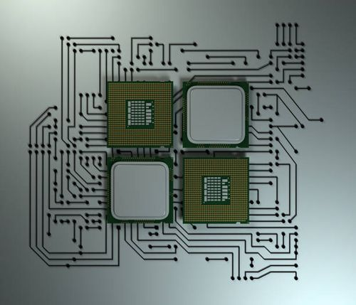
Multi-Core Processors
A multi-core processor contains multiple CPU cores integrated onto a single integrated circuit die.
→
Independence: Each core can process threads and instructions entirely independently.
→
Multitasking: Drastically improves the server's ability to handle simultaneous user requests.
→
Virtualization: Essential for running multiple Virtual Machines (VMs) on a single physical host.

Slide 11
CPU Sockets
Connection: Sockets connect processors directly to the motherboard.
Function: They provide both the physical mounting mechanism and the critical electrical connections.
Multi-Socket: Enterprise servers often feature motherboards that support multiple CPU sockets (Dual-socket, Quad-socket).
Scaling: Multiple sockets allow massive scaling of total processing cores within a single chassis.

Slide 12
Server RAM (Random Access Memory)
Temporary Storage: RAM temporarily holds data and instructions actively being used by the CPU.
Workload Capacity: More RAM directly enables servers to handle larger databases and more concurrent users.
Server Grade: Unlike consumer memory, server memory prioritizes extreme reliability and massive scalability.

Slide 13


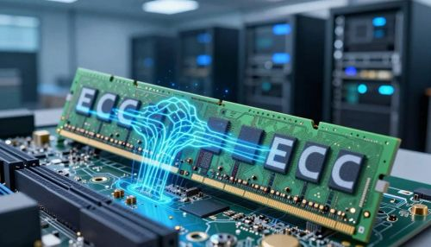

ECC Memory (Error-Correcting Code)
What is ECC?
How it Works
ECC stands for Error-Correcting Code. It is a specialized type of memory used almost exclusively in servers and workstations.
It includes an extra memory chip that continuously detects and corrects single-bit memory errors on the fly.
Why it Matters
ECC prevents silent data corruption and system crashes caused by random electrical interference or cosmic rays, ensuring continuous uptime.

Slide 14
Registered Memory (RDIMM)
Design: Registered RAM utilizes a hardware register placed between the memory controller and the DRAM modules.
Electrical Load: This register significantly reduces the electrical load placed on the CPU's memory controller.
Capacity: Lower electrical load allows server motherboards to support vastly larger total memory capacities (e.g., Terabytes of RAM).

Slide 15







System Bus Types
A bus provides the communication pathways between internal computer components.
Data Bus
Address Bus
Control Bus
Transfers actual data bits between the CPU, memory, and peripherals.
Carries information about exactly where data needs to be read from or written to.
Carries control and timing signals to synchronize operations across the board.

Slide 16
Memory Bus Channels
Pathways: Memory channels provide the direct communication paths between the CPU and the RAM modules.
Bandwidth: More channels operating simultaneously provide significantly higher aggregate memory bandwidth.
Configurations:
• Single-channel (Consumer baseline)
• Dual-channel (Standard desktop/server)
• Quad-channel & Octa-channel (High-end enterprise servers)

Slide 17


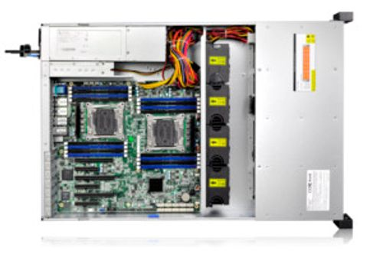
Expansion Slots (PCIe)
Purpose
Expansion slots allow administrators to install additional hardware capabilities directly onto the motherboard. PCI Express (PCIe) is the universal high-speed standard used in modern servers.
Common Add-in Cards
→
10G/40G Network Interface Cards (NICs)
→
Hardware RAID Controllers
→
GPU Accelerators for AI/VDI

Slide 18
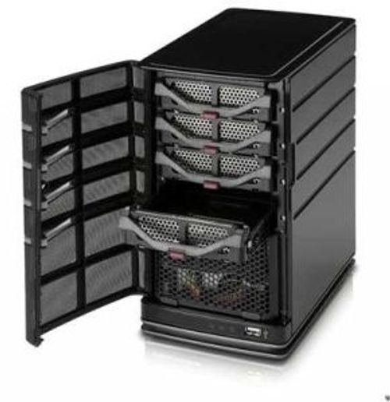
Server Storage
Storage systems keep data permanently, surviving reboots and power cycles. Storage selection balances performance, capacity, reliability, and cost.
→
HDD: Hard Disk Drives (Magnetic)
→
SSD: Solid-State Drives (Flash SATA/SAS)
→
NVMe: Non-Volatile Memory Express (Flash PCIe)

Slide 19
Hard Disk Drives (HDD)
Technology: Uses spinning magnetic platters and mechanical read/write heads to store data.
Advantages: Offers massive storage capacity limits at the absolute lowest cost per Gigabyte. Excellent for bulk archiving.
Disadvantages: Inherently slower due to mechanical seek times. Moving parts increase the risk of physical failure over time compared to flash media.

Slide 20
Solid-State Drives (SSD)
Technology: Uses NAND flash memory chips to store data electronically.
Advantages: Drastically faster access times and lower latency than HDDs. Zero moving parts makes them highly resistant to physical shock and vibration.
Use Case: Commonly deployed for operating systems, application installations, and active databases requiring fast I/O.

Slide 21



NVMe Storage
What is NVMe?
How it Connects
NVMe stands for Non-Volatile Memory Express. It is a modern storage protocol designed specifically to maximize the capabilities of flash memory.
Unlike SATA/SAS SSDs, NVMe drives connect directly via the high-speed PCIe bus, bypassing legacy storage controllers entirely.
Performance Impact
Provides extremely high throughput, massive IOPS, and ultra-low latency, making it the premier choice for high-performance databases and caching tiers.

Slide 22
Storage Comparison
Technology | Medium | Performance | Primary Benefit
HDD | Magnetic Platters | Baseline / Slowest | High Capacity, Low Cost
SSD (SATA/SAS) | Flash Memory | Fast (No moving parts) | Balance of Speed and Price
NVMe | Flash over PCIe | Ultra-Fast | Maximum Throughput, Low Latency

Slide 23
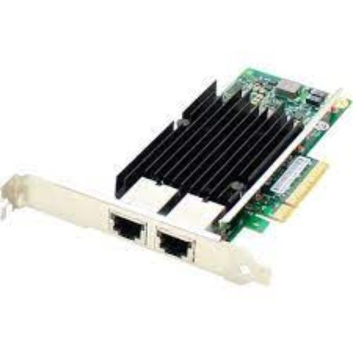
Network Interface Cards (NICs)
→
A NIC physically connects the server to the data center network.
→
Supports various physical media, primarily Copper Ethernet (RJ45) and Fiber Optics (SFP+).
→
Important selection features:
→
• Network Speed (1G, 10G, 40G, 100G)
→
• Number of Ports (Dual/Quad port for redundancy)

Slide 24
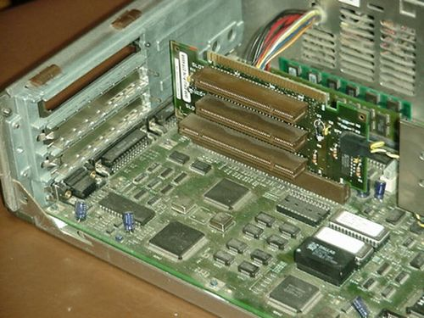
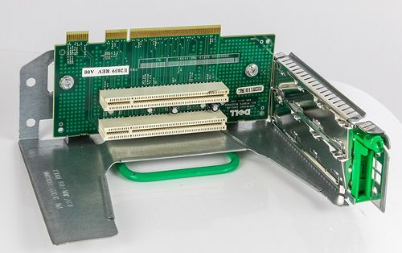
Riser Cards
Function: Riser cards plug into the motherboard and allow expansion cards to be installed at a 90-degree angle (parallel to the motherboard).
Form Factor: Highly common in 1U and 2U rack servers where vertical space is severely limited.
Space Saving: They help save internal chassis space while still providing access to necessary PCIe lanes for NICs and RAID controllers.

Slide 25
RAID Controllers
Management: Hardware controllers that manage multiple physical storage drives and present them to the OS as a single logical RAID array.
Capabilities: Can provide data redundancy (mirroring/parity) and improve read/write performance (striping).
Hardware Advantage: Dedicated hardware RAID controllers include their own processing chip and onboard cache memory, offloading storage overhead from the server's main CPU.

Slide 26





Common RAID Levels
RAID 0
RAID 1
RAID 5
Striping: Combines drives for maximum performance and capacity. No redundancy.
Mirroring: Exact duplicate of data across two drives. High redundancy, 50% capacity loss.
Parity: Striping with distributed parity. Can survive 1 drive failure. Good balance of space and safety.
RAID 6
RAID 10
Dual Parity: Similar to RAID 5 but can survive 2 simultaneous drive failures.
Stripe of Mirrors: Combines RAID 1 redundancy with RAID 0 performance. Requires 4+ drives.

Slide 27
BIOS and UEFI
Initialization
The Modern Standard
BIOS and UEFI are low-level software that initialize and test hardware components during the server startup process (POST).
UEFI (Unified Extensible Firmware Interface) is the modern, secure, and graphical replacement for the legacy BIOS system.
Configuration Roles
They provide the interface to configure baseline hardware settings, define boot devices, enable virtualization, and enforce secure boot policies.

Slide 28


Common BIOS/UEFI Settings
•
Boot Order: Which device to load the OS from.
•
Virtualization: Enabling Intel VT-x or AMD-V for hypervisors.
•
CPU Configuration: Enabling Hyper-Threading or specific cores.
•
Storage Config: Setting SATA modes (AHCI/RAID).
•
Memory Config: Speeds and ECC reporting.
•
Security: Secure Boot and TPM activation.

Slide 29
Boot Configuration
Definition: Boot configuration dictates exactly where the server looks to find and load an operating system.
Common Boot Sources:
• Internal Storage (RAID arrays, NVMe)
• USB Devices (For OS installation media)
• Network/PXE (Preboot Execution Environment for network deployment)
• Optical Media (Legacy CD/DVD)

Slide 30
What is Firmware?
Definition: Firmware is specialized software permanently stored inside a hardware component's non-volatile memory.
Function: It acts as the "operating system" for that specific piece of hardware, controlling its low-level operations.
Server Locations: Firmware exists extensively across a server, including the BIOS/UEFI, RAID controllers, NICs, BMCs (Management controllers), and the storage drives themselves.

Slide 31


Firmware Updates
Why Update?
Keeping firmware current is a critical maintenance task. Updates are released by vendors to:
→
Fix known hardware bugs and logic errors.
→
Improve compatibility with new OS versions or hardware.
→
Patch critical security vulnerabilities (e.g., Spectre/Meltdown).
→
Add new performance features.
Warning
Updates must be performed carefully during maintenance windows, as a power failure during a flash process can permanently "brick" the component.

Slide 32
USB Interfaces and Ports
Connectivity: USB ports are the standard for connecting local external peripherals to the server.
Common Uses:
• Crash cart hookups (Keyboard and mouse)
• Temporary USB storage drives
• Bootable media for OS installation and firmware updates
Speeds: Different USB versions (2.0, 3.0, 3.2, Type-C) dictate the data transfer rates available.

Slide 33
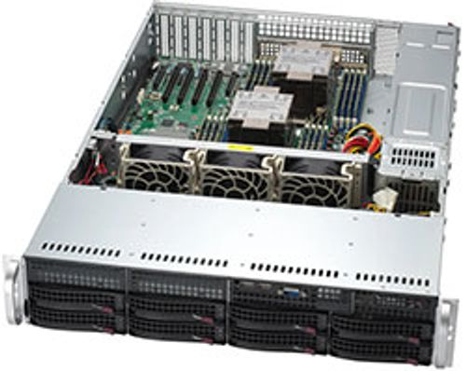
Hot-Swappable Components
→
Hot-swappable hardware can be safely removed and replaced while the server remains powered on and running.
→
Common Examples: Hard drives, SSDs, redundant power supplies, and chassis cooling fans.
→
Primary Benefit: Drastically reduces server downtime for routine hardware replacements.

Slide 34
Server Power Requirements
Stability: Enterprise servers demand highly stable, conditioned, and sufficient electrical power to operate reliably.
Consumption Factors: Total power draw fluctuates based on:
• CPU load and core count
• Amount of installed RAM
• Number of spinning storage drives
• High-draw expansion cards (like GPUs)
• Active cooling system RPMs

Slide 35



Power Supply Systems
The PSU
The UPS
The PDU
The Power Supply Unit converts AC wall power into regulated DC power for internal components.
Uninterruptible Power Supplies act as giant batteries to keep servers running during grid power outages.
Power Distribution Units are intelligent power strips mounted in the rack to distribute power to multiple servers.

Slide 36


Redundant Power Supplies
N+1 Redundancy
Enterprise servers are equipped with multiple (usually two) hot-swappable PSUs to provide power redundancy.
Failover Mechanics
Availability Target
If PSU "A" fails, or the electrical circuit it is plugged into trips, PSU "B" instantly takes over the full load without dropping the server.
This is a foundational feature for achieving high availability, ensuring a single component failure does not cause an outage.

Slide 37
Server Cooling Systems
The Threat: High-performance CPUs, memory, and drives generate massive amounts of concentrated heat during operation.
Cooling Mechanisms: Systems employ high-RPM fans pulling air across copper/aluminum heat sinks mounted on processors.
Air Ducts: Internal plastic shrouds force airflow precisely over the hottest components rather than letting it scatter.
Liquid Cooling: Increasingly used in ultra-dense HPC and AI servers where air cooling is insufficient.

Slide 38
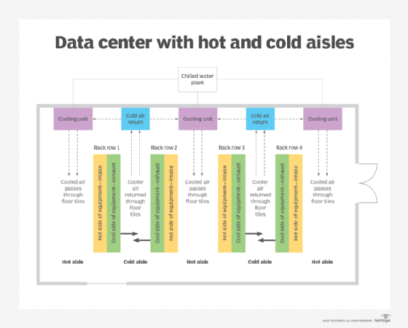
Airflow Management
→
Strict directional airflow prevents hot exhaust from recirculating into intakes.
→
Typical Flow:
1. Cool air enters from the front bezel.
2. High-speed fans push air through internal components (CPU, RAM).
3. Hot air exhausts out the rear of the chassis.
→
Datacenters align racks into "Hot Aisles" and "Cold Aisles" to optimize this pattern globally.

Slide 39



The Importance of Proper Airflow
Prevents Overheating
Hardware Reliability
Prevents Throttling
Keeps components well below critical failure temperatures.
Consistent, lower temperatures significantly extend the lifespan of electronics.
Modern CPUs will intentionally slow down (thermal throttle) if they get too hot. Good airflow maintains maximum performance.

Slide 40
Server Hardware Maintenance
Routine Checks: Regular maintenance is the key to long-term reliability and avoiding unplanned downtime.
Important Activities:
• Monitor system temperatures via BMC/IPMI
• Visually and digitally check fan RPMs and health
• Clean physical dust from front vents and bezels
• Verify redundant power supplies are both receiving power
• Monitor RAID controller logs for degraded storage health
• Schedule and apply necessary firmware updates

